Slide 1
Deep Learning Generalization
C135185 성대규 B911145 이진우
C035368 전지윤
C035455 홍기욱
C035456 홍세연

Slide 2
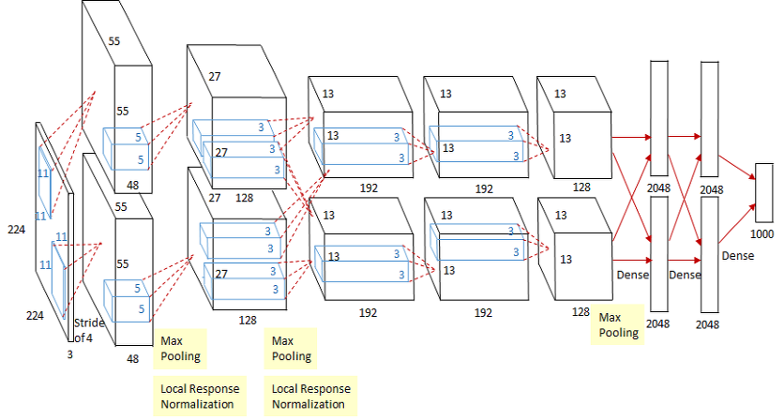
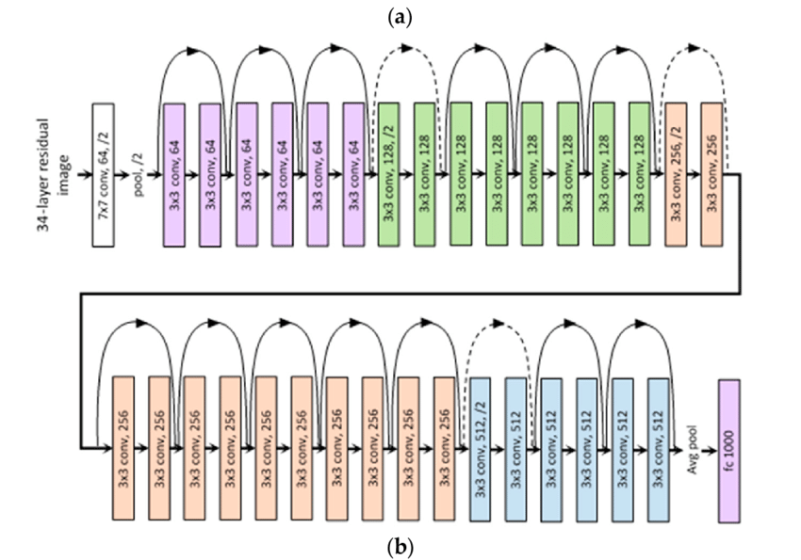
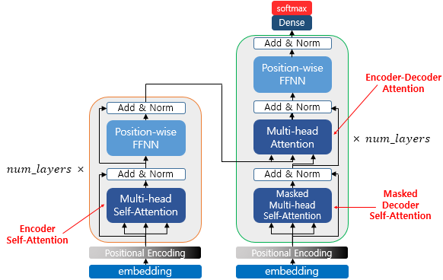
Deep learning model advance
AlexNet
ResNet
bigger model perform better!
Transformer

Slide 3
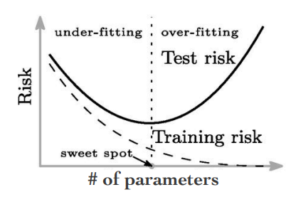
Overfitting

Slide 4
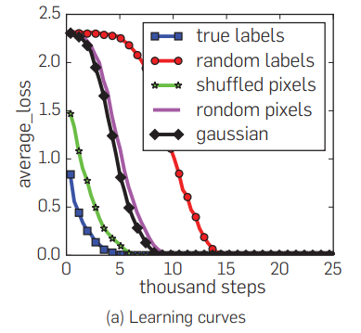
Capacity of Neural Network
Experiment setting
• True labels: the original dataset without modification.
• Random labels: all the labels are replaced with random ones.
• Shuffled pixels: a random permutation of the pixels is chosen and then the same permutation is applied to all the images in both training and test set.
• Random pixels: a different random permutation is applied to each image independently.
• Gaussian: A Gaussian distribution (with matching mean and variance to the original image dataset) is used to generate random pixels for each image.
Understanding deep learning requires rethinking generalization
(2017, Zhang, C. et al.)

Slide 5
relieve overfitting (improve generalization)
model generalization with Explicit regularization
weight decay
data augmentation
dropout
regularization
model generalization with Implicit regularization
batch normalization
early stopping
SGD

Slide 6
relieve overfitting (improve generalization)
They play core role in deep learning generalization(overfitting)??
⇒ Can they explain clearly why overfitting occurs??

Slide 7
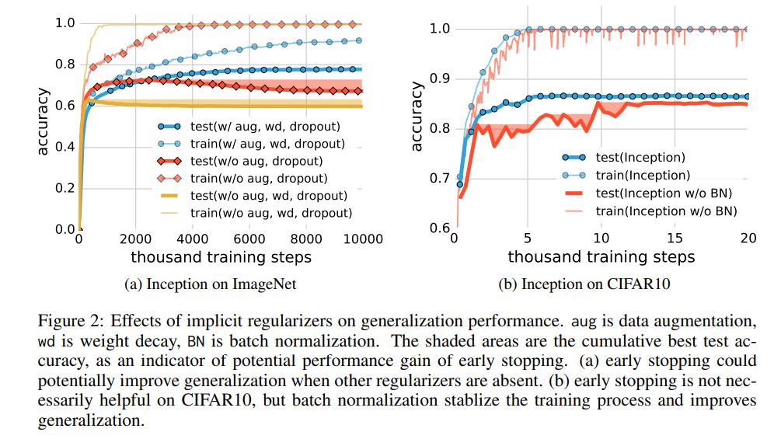
ablation study
(Understanding deep learning requires rethinking generalization (2017, Zhang C. et al.))

Slide 8
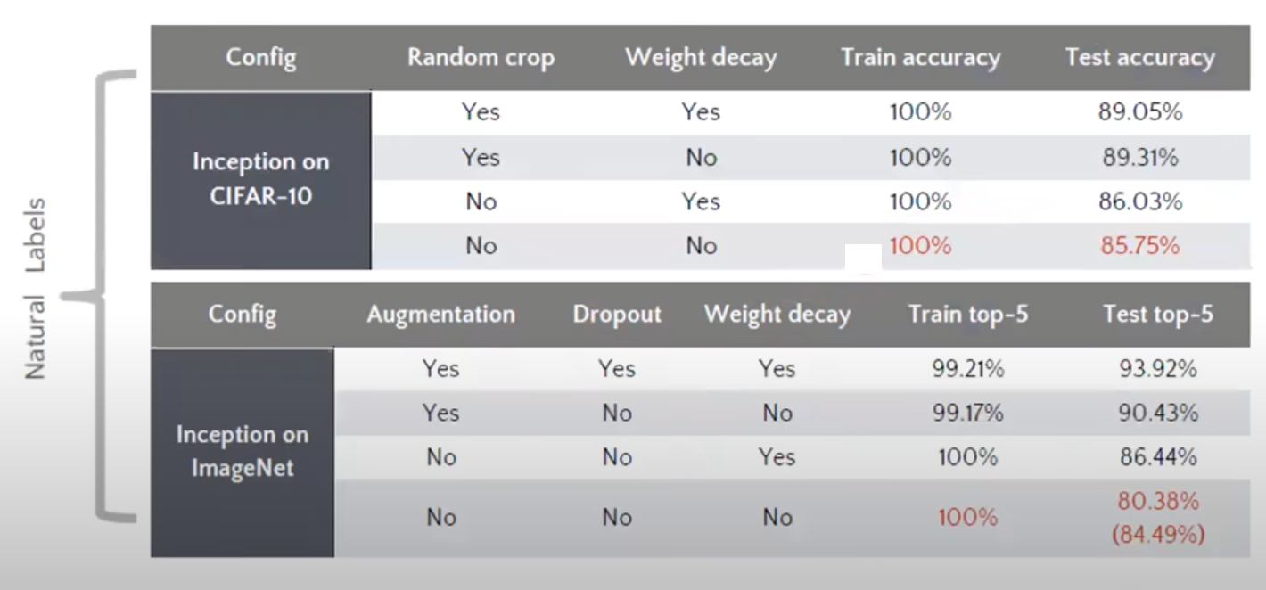
ablation study
(Understanding deep learning requires rethinking generalization (2017, Zhang C. et al.))

Slide 9
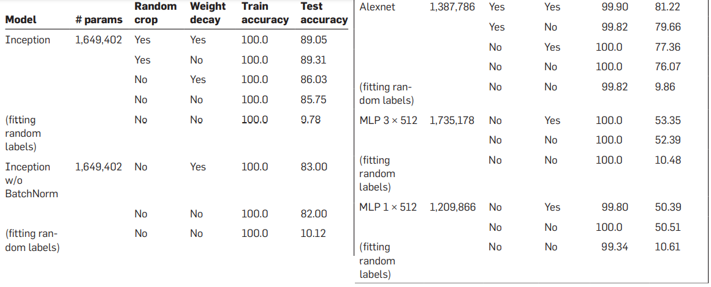
ablation study
(Understanding deep learning requires rethinking generalization (2017, Zhang C. et al.))

Slide 10
Understanding deep learning requires rethinking generalization (2017, Zhang C. et al.)
We need to rethink why deep learning model generalize well since they have huge complexity enough to memorize entire data (overfit).

Slide 11
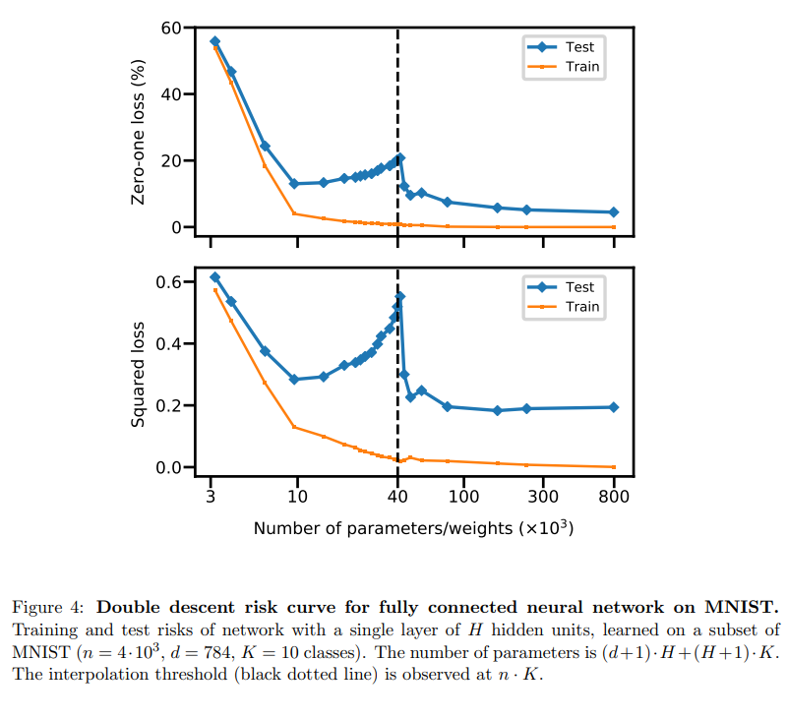
Reconciling modern machine learning practice and the bias-variance trade-off(2019, Belkin M. et al.)

Slide 12
Reconciling modern machine learning practice and the bias-variance trade-off(2019, Belkin M. et al.)

Slide 13
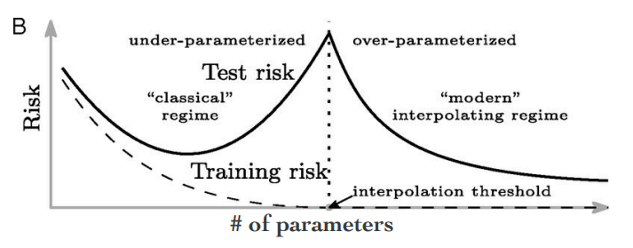
Reconciling modern machine learning practice and the bias-variance trade-off(2019, Belkin M. et al.)

Slide 14
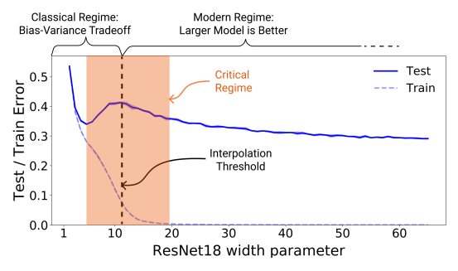
DEEP DOUBLE DESCENT: WHERE BIGGER MODELS AND MORE DATA HURT(2020, Nakkiran P. et al.)

Slide 15
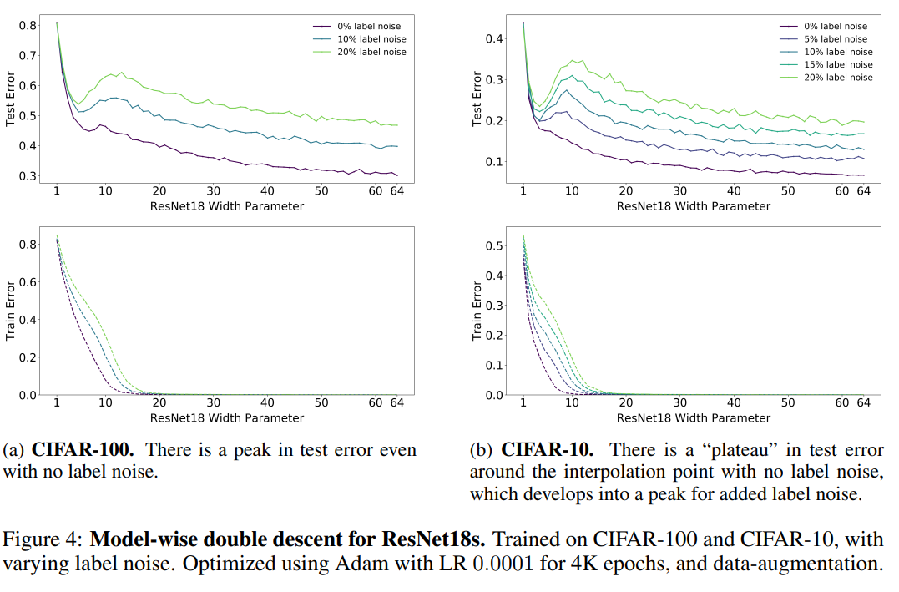
DEEP DOUBLE DESCENT: WHERE BIGGER MODELS AND MORE DATA HURT(2020, Nakkiran P. et al.)
Model-wise Double Descent on ResNet18

Slide 16
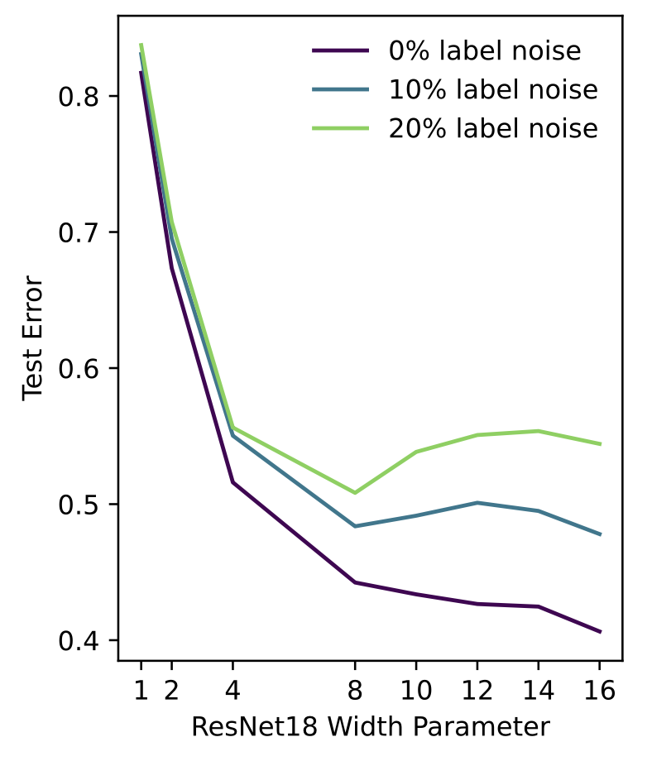
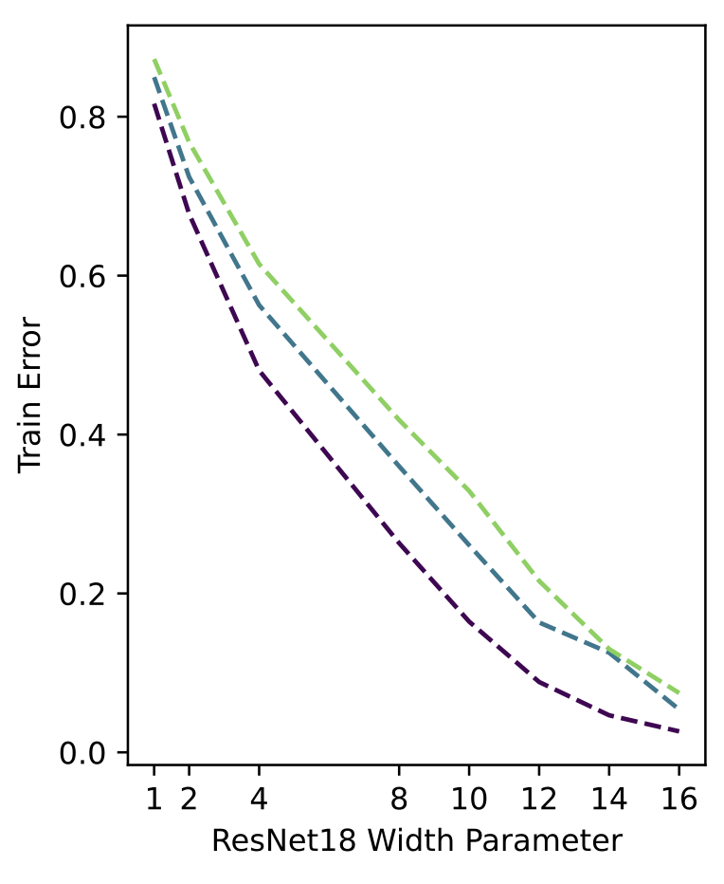
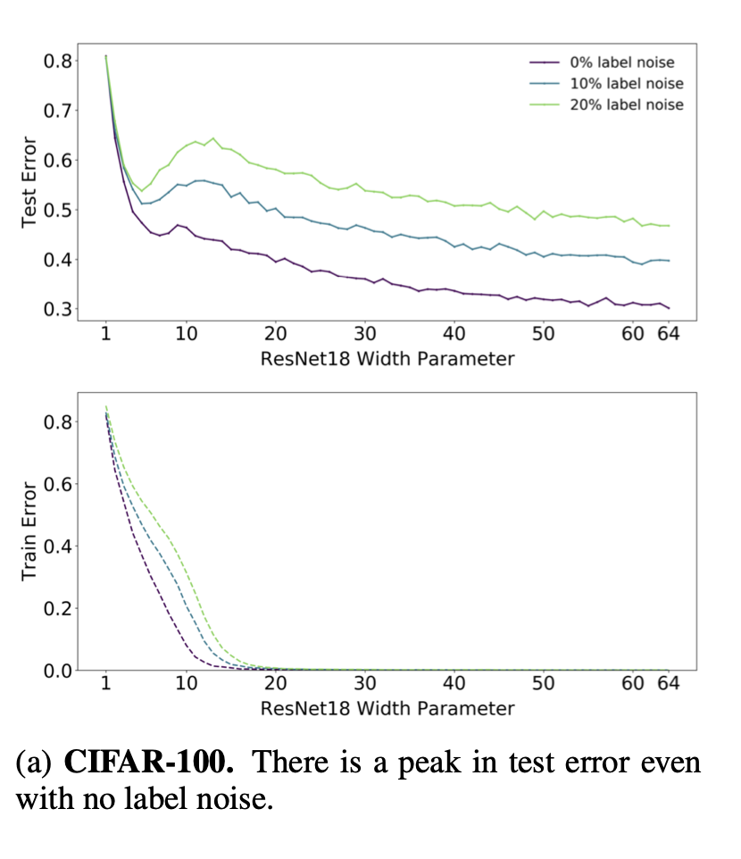
DEEP DOUBLE DESCENT: WHERE BIGGER MODELS AND MORE DATA HURT(2020, Nakkiran P. et al.)
<our experiment>
ResNet 18 CIFAR-100
label noise 0% 10% 20%
Width parameter 1, 2, 4, 8, 10, 12, 14, 16
Adam
lr = 0.0001
1000 epochs
<experiment in paper>

Slide 17
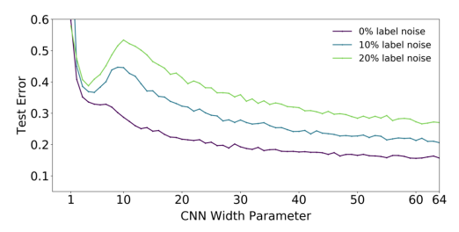
DEEP DOUBLE DESCENT: WHERE BIGGER MODELS AND MORE DATA HURT(2020, Nakkiran P. et al.)
Model-wise Double Descent on 5-layer CNN

Slide 18
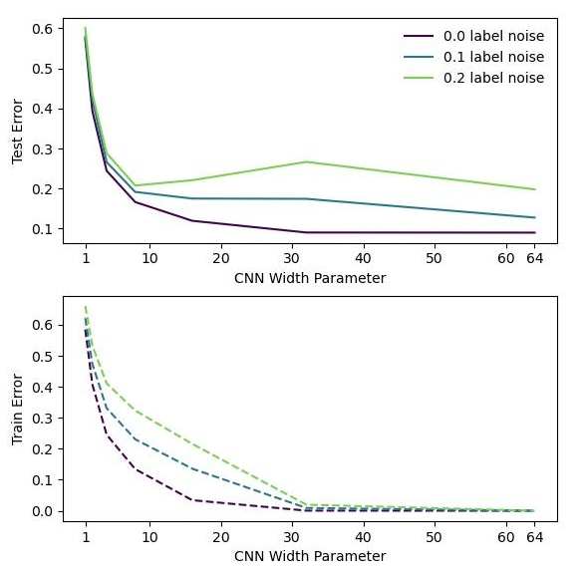
DEEP DOUBLE DESCENT: WHERE BIGGER MODELS AND MORE DATA HURT(2020, Nakkiran P. et al.)
<experiment in paper>
dataset: CIFAR-10
label noise: 0%, 10%, 20% (doesn’t matter that much)
Width parameter: 1, 2, 4, 8, 16, 32, 64
Optimizer : SGD
<our experiment>

Slide 19
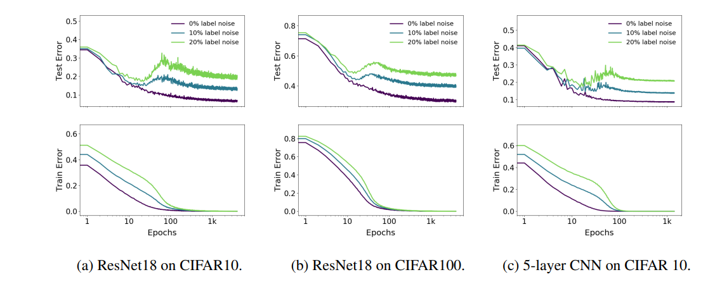
DEEP DOUBLE DESCENT: WHERE BIGGER MODELS AND MORE DATA HURT(2020, Nakkiran P. et al.)
Epoch-wise Double Descent on ResNet 18 and 5-layer CNN (width=128)

Slide 20
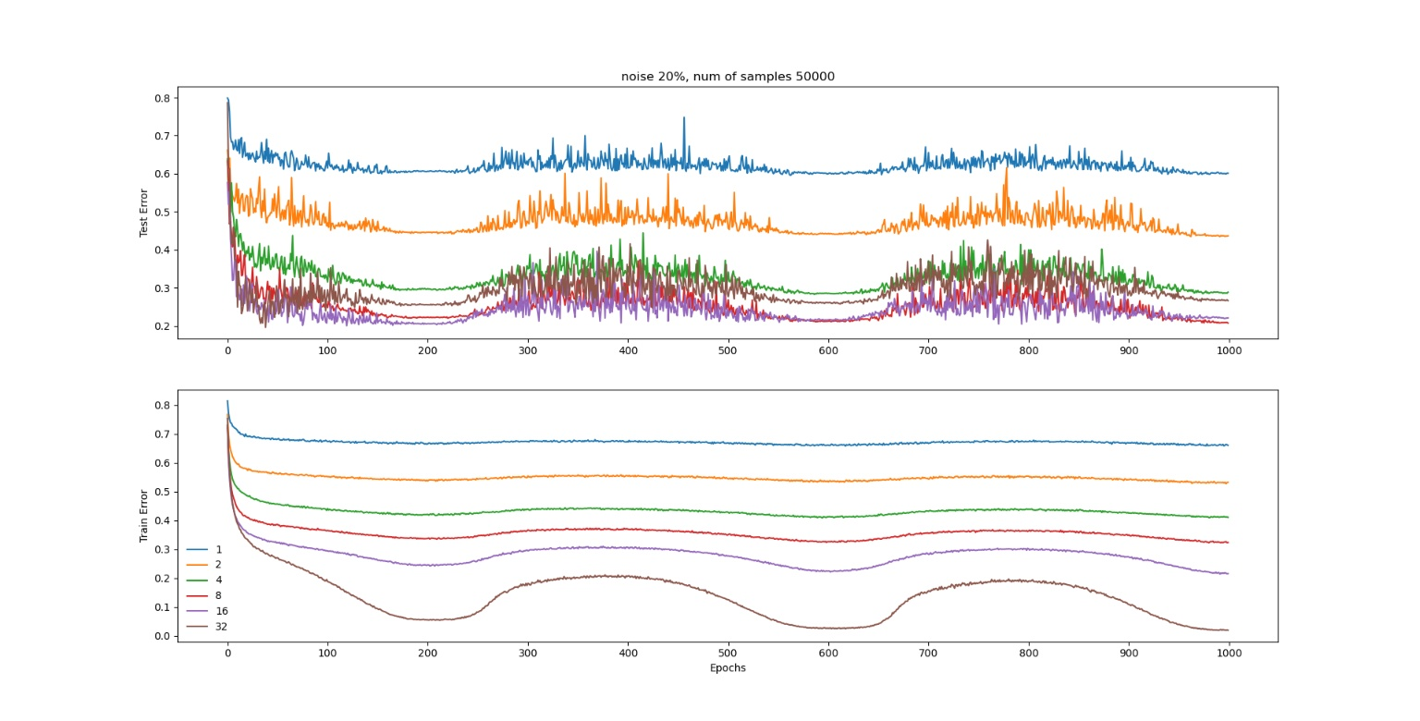
DEEP DOUBLE DESCENT: WHERE BIGGER MODELS AND MORE DATA HURT(2020, Nakkiran P. et al.)
Epoch-wise and Model-wise Double Descent on 5-layer CNN (our work)

Slide 21
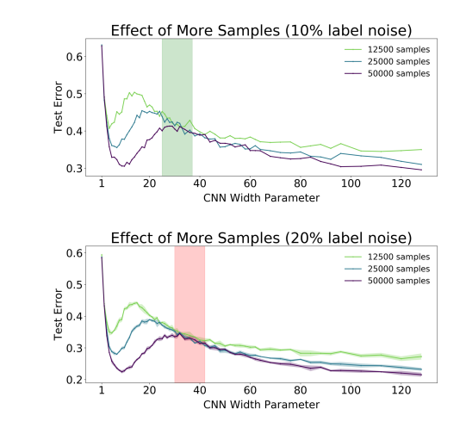
DEEP DOUBLE DESCENT: WHERE BIGGER MODELS AND MORE DATA HURT(2020, Nakkiran P. et al.)
Sample-wise Double Descent on 5-layer CNN

Slide 22
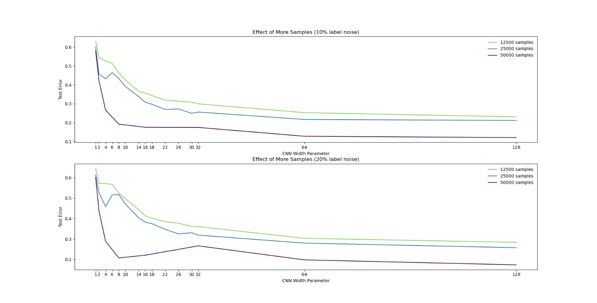
DEEP DOUBLE DESCENT: WHERE BIGGER MODELS AND MORE DATA HURT(2020, Nakkiran P. et al.)
<experiment in paper>
<our experiment>

Slide 23
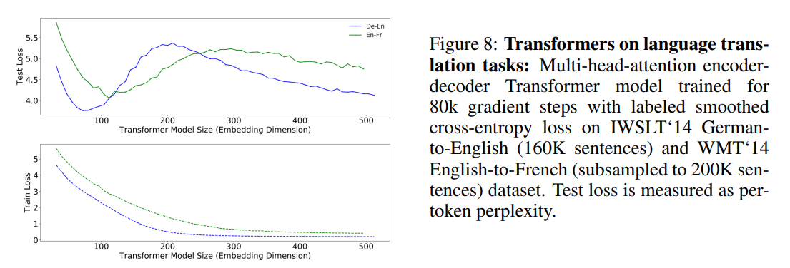
DEEP DOUBLE DESCENT: WHERE BIGGER MODELS AND MORE DATA HURT(2020, Nakkiran P. et al.)
Double Descent on Transformer (attention is all you need)

Slide 24
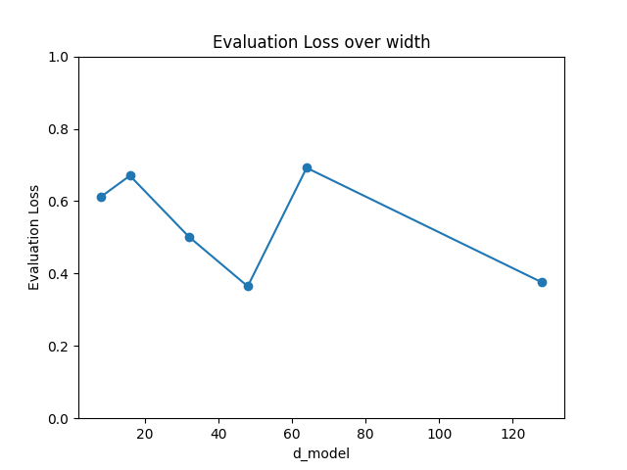
DEEP DOUBLE DESCENT: WHERE BIGGER MODELS AND MORE DATA HURT(2020, Nakkiran P. et al.)
model : bert-base
task : text classification
dataset : imdb
pre-trained : No
width parameter(d_model) : 8, 16, 32, 48, 64, 128
head num ; 8
hidden layer : 6
optimizer : Adam
initialize : Gaussian
batch size : 16
trained 62.5K steps
<our experiment>

Slide 25
Conclude
deep learning is different from our knowledge

Slide 26
Conclude
(current works)
Analysis deep-learning using model architecture
Benign overfitting in linear regression(2020, Bartlett, P. et al.)
On the implicit bias in deep-learning algorithm(2023, Vardi G.)
Analysis deep-learning using gradient
Implicit bias of the step size in linear diagonal neural network(2022, Nacson M. S. et al.)
On implicit bias in overparameterized bilevel optimization (2022, Vicol P. et al.)

